Slide 1
Environmental Sensors
BY:
Mr S. R .Chawade
Faculty ,Engineering Physics KJSCE

Slide 2
What is an environment?
Environment is everything that is around us
Most important components of this are air, water, and land in or on which people, animals, and plants live
There are many aspects associated with these components
Our study is limited to the the two aspects
1)Temperature.
2)Humidity

Slide 3
Temperature Sensors
Temperature sensor: It is used to measure the amount of energy in the form of heat and cold produced by an object and system
It allows one to sense or detect any physical change due to that energy and gives the electrical output in the analogue or digital form which can be further processed.

Slide 4
Type of Temperature Sensors
Temperature sensors are mainly of following types
1)Thermostat
2)Thermistors
3)Thermocouple
4)Expansion type
5)Liquid crystal
First three are mainly used for Industrial ,IOT applications .

Slide 5
Thermostat
The thermostat is a kind of contact temperature sensor employing an electro-mechanical component and using two different kinds of metals nickel, copper, tungsten or aluminium etc, Having substantial difference in coefficient of expansion with temperature.
These metals are stuck together to form a Bi-metallic strip
Most common strips are Steel-Brass, Steel-Copper/Nickel/Tungston/Aluminium
These strips bends and the temperature can be measured in terms of extent of bending. Extent of bending can be calibrated in terms of temperature
It also has applications in electrical and electronics for making and breaking of the circuits.

Slide 6
Thermistor
The term is the combination of Thermal – Resistors
The thermistor is another type of temperature sensitive device whose electrical resistance changes as the object temperature changes.
This is made up of semiconductor materials or metallic oxides, pressed into a bead, disk, or cylindrical shape and then encapsulated with an impermeable material such as epoxy or glass.
.

Slide 7
Types of Thermistor
Negative-temperature-coefficient (NTC) thermistors have less resistance at higher temperatures, while positive-temperature-coefficient (PTC) thermistors have more resistance at higher temperatures..
Thermistors are used for precise temperature measurement, control and compensation.

Slide 8
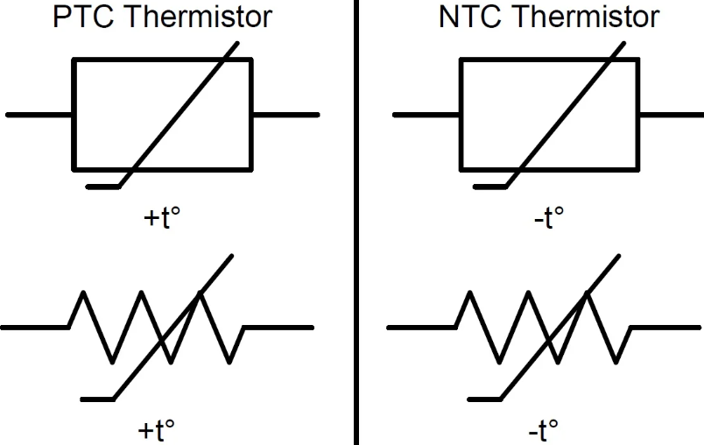
Symbols of Thermistor

Slide 9
Thermocouple
Thermocouple based sensors are most widely used sensors in industry
Thermocouple are based on Seebeck Efeect
Its converse of seebeck effect is Peltiers Effect

Slide 10
Seebeck Effect
If one junction of metal pair (Thermo couple ) is kept hot and other cold, it is observed that galvanometer shows deflection. This means an e.m.f. is generated in the circuit. The e.m.f. thus produced is called thermo e.m.f. and the resulting current is known as thermoelectric current. Hence, the phenomenon of generation of e.m.f. in a thermocouple when its two junctions are at different temperature is known as Seebeck Effect.

Slide 11
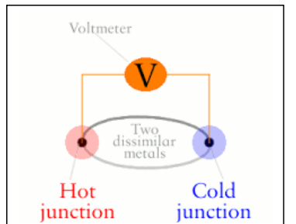
Seebeck Effect

Slide 12
Physics Behind Seebeck Effect
Seebeck effect is a manifestation of the fact that if two points in a conductor (or a semiconductor) are maintained at different temperatures, the charged carriers (electrons or holes) in the hotter region, being more energetic (and, therefore, having higher velocities) diffuses towards region of lower temperature. The diffusion stops when the electric field generated because of movement of charges has established a strong enough field to stop further movement of charges.

Slide 13
Physics Behind Seebeck Effect
For a metal, carriers being negatively charged electrons, the colder end would become negative so that Seebeck coefficient is negative. For a p-type semiconductor on the other hand, holes diffuse towards the lower temperature resulting in a positive Seebeck coefficient.

Slide 14
Variation of e.m.f with temperature:
In a thermocouple, as we increase the temperature of the hot junction, keeping the cold junction at 0° C, the thermo e.m.f increases with increase in temperature till it reaches to it its maximum limit. Then for further increase in temperature of hot junction, thermo e.m.f begins to decrease till it returns to zero.

Slide 15
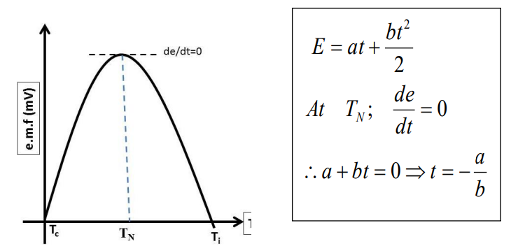
Variation of e.m.f with temperature:
.

Slide 16
Seebeck Coefficient
. Performance of a thermocouple is determined by the Seebeck coefficient of the pair of metals forming the thermocoupl.
‘a’ And ‘b’are the constants the value of which depends on particular pair (Thermocouple)
Unit of ‘a’ is micro volts /degree Celsius (µv/⁰c)
Unit of ‘b’ is micro volts /degree Celsius (µv/⁰c²)
de/dt is called as the thermoelectric power

Slide 17
Various terms related to Seebeck effect
Neutral Temperature (t_{n}):Is the temperature difference beyond which the thermo e.m.f. starts decreasing .
t_{n} = -a/b
Temperature of Inversion (t_{i})
Is the temperature difference at which current is zero the temperature beyond which direction of current changes .

Slide 18
Humidity sensor
Humidity is the amount of water present in the surrounding air .
Hygrometer is the device which measures humidity directly.
Humidity is a non-electrical quantity that is converted into electrical quantity by using resistance, capacitance and impedance properties.
Normally term relative humidity is used which is given in terms of percentage
The instrument use to measure humidity is called as the hygrometer
Humidity sensors are used in industry, agriculture, medical field, environment monitoring etc.

Slide 19
Types of Humidity sensor(hygrometers)
Resistive
Capacitive
Aluminium Oxide
Crystal
Microwave refractometer

Slide 20
Resistive hygrometer
In a resistive hygrometer, the main element is a material whose resistance changes with the change in humidity or relative humidity. A wire or electrode coated with hydroscopic salt (lithium chloride) can be used for measurement of the humidity.

Slide 21
Crystal Hygrometer
In a crystal hygrometer, crystals are coated with hydroscopic materials (hydroscopic polymers). These crystals are used as frequency determination elements in the oscillator, and therefore just like with the capacitive hygrometer, if there is change in humidity then frequency also changes. Frequency changes due to the humidity as the mass of the crystal changes with amount of water absorbed by the coating. This change in frequency is measured.

Slide 22
Microwave refractometer
A microwave refractometer consists of two cavities, each coupled with Klystron, a material which produces microwaves in which one cavity is filled with dry air and another cavity is filled with a mixture whose humidity is to be measured.

Slide 23
Capacitive hygrometer
In a capacitive hygrometer, the changes in humidity are caused by the changes in the capacitance. Dielectric medium is used in the capacitor and the capacitor consists of two electrodes or plates and a dielectric medium is there between the plates. There is also some hydroscopic material which exhibits the change in dielectric constant with the change in the humidity. Therefore, such hydroscopic material or salt can also be used for construction of a capacitive hygrometer.

Slide 24
Capacitive hygrometer
In a capacitive hygrometer, the changes in humidity are caused by the changes in the capacitance. Dielectric medium is used in the capacitor and the capacitor consists of two electrodes or plates and a dielectric medium is there between the plates. There is also some hydroscopic material which exhibits the change in dielectric constant with the change in the humidity. Therefore, such hydroscopic material or salt can also be used for construction of a capacitive hygrometer.

Slide 25
Aluminium oxide hygrometer
It is a capacitive type hygrometer, aluminium oxide is coated on anodized aluminium and this aluminium oxide exhibits a change in the dielectric constant with respect to changes in humidity. This change can be measured to measure the humidity by bridge or electric method.

Slide 26
Exercise
1) For Fe-Cu thermocouple the neutral temperature is 285ºC when the cold junction temperature is 0ºC. Calculate the temperature of inversion if the cold junction temperature is -30ºC.
2) The thermo emf of a Cu-Fe thermocouple of 2160µV when the cold junction is 0ºC and the hot junction at 250ºC. Calculate the constants a and b if the neutral temperature is 330ºC.
For Fe-Cu thermocouple, when one of the junction A is at 273ºK, the thermoelectric current is found to be zero when other junction B is at 843ºK. On further increasing the temperature of junction B the current is found to change its direction of flow. Calculate the temperature at which maximum E.M.F, is obtained and the temperature of inversion of cold junction temperature is 250ºK

Slide 27


